Slide 1
HTML SESSIONS
ONLINE WEBINAR #1

Slide 2
HTML INTRODUCTION
HTML is the standard markup language for creating Web pages.

Slide 3
WHAT IS HTML?
HTML stands for Hyper Text Markup Language
HTML is the standard markup language for creating Web pages
HTML describes the structure of a Web page
HTML consists of a series of elements
HTML elements tell the browser how to display the content
HTML elements label pieces of content such as "this is a heading", "this is a paragraph", "this is a link", etc.

Slide 4
SIMPLE HTML DOCUMENT
<!DOCTYPE html>
<html>
<head>
<title>Page Title</title>
</head>
<body>
<h1>My First Heading</h1>
<p>My first paragraph</p>
</body>
</html>

Slide 5
EXPLAINATION
<!DOCTYPE html>
This Declaration Line Defines That This Document is an HTML5 Document
<html>
This Elements is the root element of an HTML page
<head>
This Element contains meta Information about the HTML page
<title>
This Elements specifies a title for that HTML page (Which is shown in the
browser’s title bar or in the page’s tab)

Slide 6
EXPLAINATION
<body>
This Element defines the document’s body, and is a container for all the
Visible contents, such as headings , paragraphs , images , hyperlinks
Lists , etc.
<h1>
This Element defines a Large heading
<p>
This Element defines a paragraph

Slide 7
WHAT IS AN HTML ELEMENT?
An HTML element is defined by a start tag, some content, and an end tag
<tagname>Content goes here...</tagname>
The HTML element is everything from the start tag to the end tag:
<h1>My First Heading</h1>
<p>My first paragraph.</p>
Note: Some HTML elements have no content (like the <br> element). These elements are called empty elements. Empty elements do not have an end tag!

Slide 8
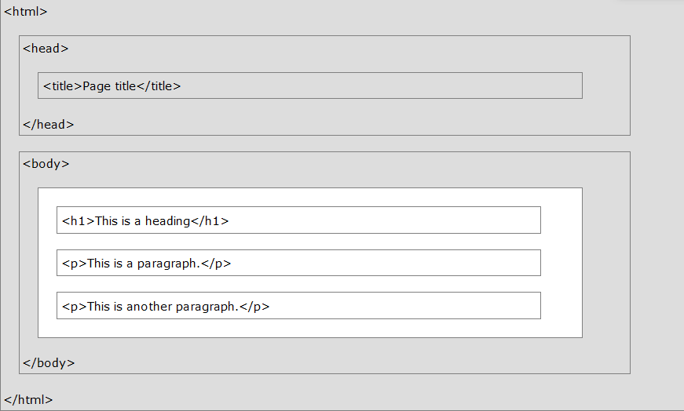
HTML PAGE STRUCTURE

Slide 9
HTML HISTORY
Year | Version
1989 | Tim Berners-Lee invented www
1991 | Tim Berners-Lee invented HTML
1993 | Dave Raggett drafted HTML+
1995 | HTML Working Group defined HTML 2.0
1997 | W3C Recommendation: HTML 3.2
1999 | W3C Recommendation: HTML 4.01
2000 | W3C Recommendation: XHTML 1.0
2008 | WHATWG HTML5 First Public Draft
2012 | WHATWG HTML5 Living Standard
2014 | W3C Recommendation: HTML5
2016 | W3C Candidate Recommendation: HTML 5.1
2017 | W3C Recommendation: HTML5.1 2nd Edition
2017 | W3C Recommendation: HTML5.2

Slide 10
HTML DOCUMENTS
All HTML documents must start with a document type declaration:
<!DOCTYPE html>.
The HTML document itself begins with <html> and ends with </html>.
The visible part of the HTML document is between <body> and </body>.

Slide 11
THE <!DOCTYPE> DECLARATION
The <!DOCTYPE> declaration represents the
document type, and helps browsers to display web pages
correctly.
It must only appear once, at the top of the page
(before any HTML tags).
The <!DOCTYPE> declaration is not case sensitive.
The <!DOCTYPE> declaration for HTML5 is:
<!DOCTYPE html>

Slide 12
HTML HEADINGS
HTML headings are defined with the
<h1> to <h6> tags.
<h1> defines the most important heading.
<h6> defines the least important heading:
EXAMPLE:
<h1>This is heading 1</h1>
<h2>This is heading 2</h2>
<h3>This is heading 3</h3>

Slide 13
HTML PARAGRAPHS
HTML paragraphs are defined with the <p> tag:
EXAMPLE:
<p>This is a paragraph.</p>
<p>This is another paragraph.</p>

Slide 14
HTML LINKS
HTML links are defined with the <a> tag:
EXAMPLE:
<a href="https://www.google.com">This is a link</a>

Slide 15
Html image
HTML images are defined with the <img> tag
EXAMPLE:
<img src=“image1.jpg" alt=“image" width="104" height="142">

Slide 16
HOW TO VIEW HTML SOURCE?
View HTML Source Code:
Right-click in an HTML page and select "View Page Source" (in Chrome) or "View Source" (in Edge), or similar in other browsers. This will open a window containing the HTML source code of the page.
Inspect an HTML Element:
Right-click on an element (or a blank area), and choose "Inspect" or "Inspect Element" to see what elements are made up of (you will see both the HTML and the CSS). You can also edit the HTML or CSS on-the-fly in the Elements or Styles panel that opens.

Slide 17
HTML ELEMENTS
An HTML element is defined by a start tag, some content, and an end tag.
<tagname>Content goes here...</tagname>
The HTML element is everything from the start tag to the end tag:
<h1>My First Heading</h1>
<p>My first paragraph.</p>

Slide 18
HTML ELEMENTS
<h1> | My First Heading | </h1>
<p> | My first paragraph. | </p>
<br> | none | none
Note: Some HTML elements have no content (like the <br> element). These elements are called empty elements. Empty elements do not have an end tag!

Slide 19
NESTED ELEMENTS
HTML elements can be nested (this means that elements can contain other elements).
All HTML documents consist of nested HTML elements.
<!DOCTYPE html>
<html>
<body>
<h1>My First Heading</h1>
<p>My first paragraph.</p>
</body>
</html>

Slide 20
Example explained
The <html> element is the root element and it defines the whole HTML document.
It has a start tag <html> and an end tag </html>.
Then, inside the <html> element there is a <body> element:

Slide 21
Example explained
<body>
<h1>My First Heading</h1>
<p>My first paragraph.</p>
</body>

Slide 22
THANK YOU VERY MUCH

